Slide 1
Microelectronics Overview and Importance to the U.S. Department of Defense (DoD)
March 2022
Presented by: Ryan Fowler
4695 Millennium Drive Belcamp, MD 21017-1505
dsiac.org
Office: 443.360.4600 Fax: 410.272.6763 Email: contact@dsiac.org
DISTRIBUTION STATEMENT A. Approved for public release: distribution unlimited.
Notes:
Welcome to the Presentation on the Tyranny of Distance in Homeland Defense… Weapons of Mass Destruction and Response in USINDOPACOM.
2 COCOMs with an HD mission – USNORTHCOM and USINDOPACOM Today I will discuss the Homeland Defense mission in the islands of the Pacific including the state of Hawaii, the territories of Guam and American Samoa, and the countries in a Compact of Free Association with the US: Palau, the Federated States of Micronesia, and the Republic of the Marshall Islands. The United States is responsible for the defense of the three sovereign nations, and therefore, fall under the Homeland Defense mission of the United States. They lack any internal military forces; their citizens are free to join the United States military.

Slide 2
What Are Microelectronics?
Microelectronics refer to electronic designs that are typically in the micrometer scale or smaller.
This area of electronics spawned from the high demand for smaller, more convenient, and less expensive devices.
According to Moore’s law, as time passes, the capabilities of these electronics increase while the expected size decreases.
DISTRIBUTION STATEMENT A. Approved for public release: distribution unlimited.

Slide 3
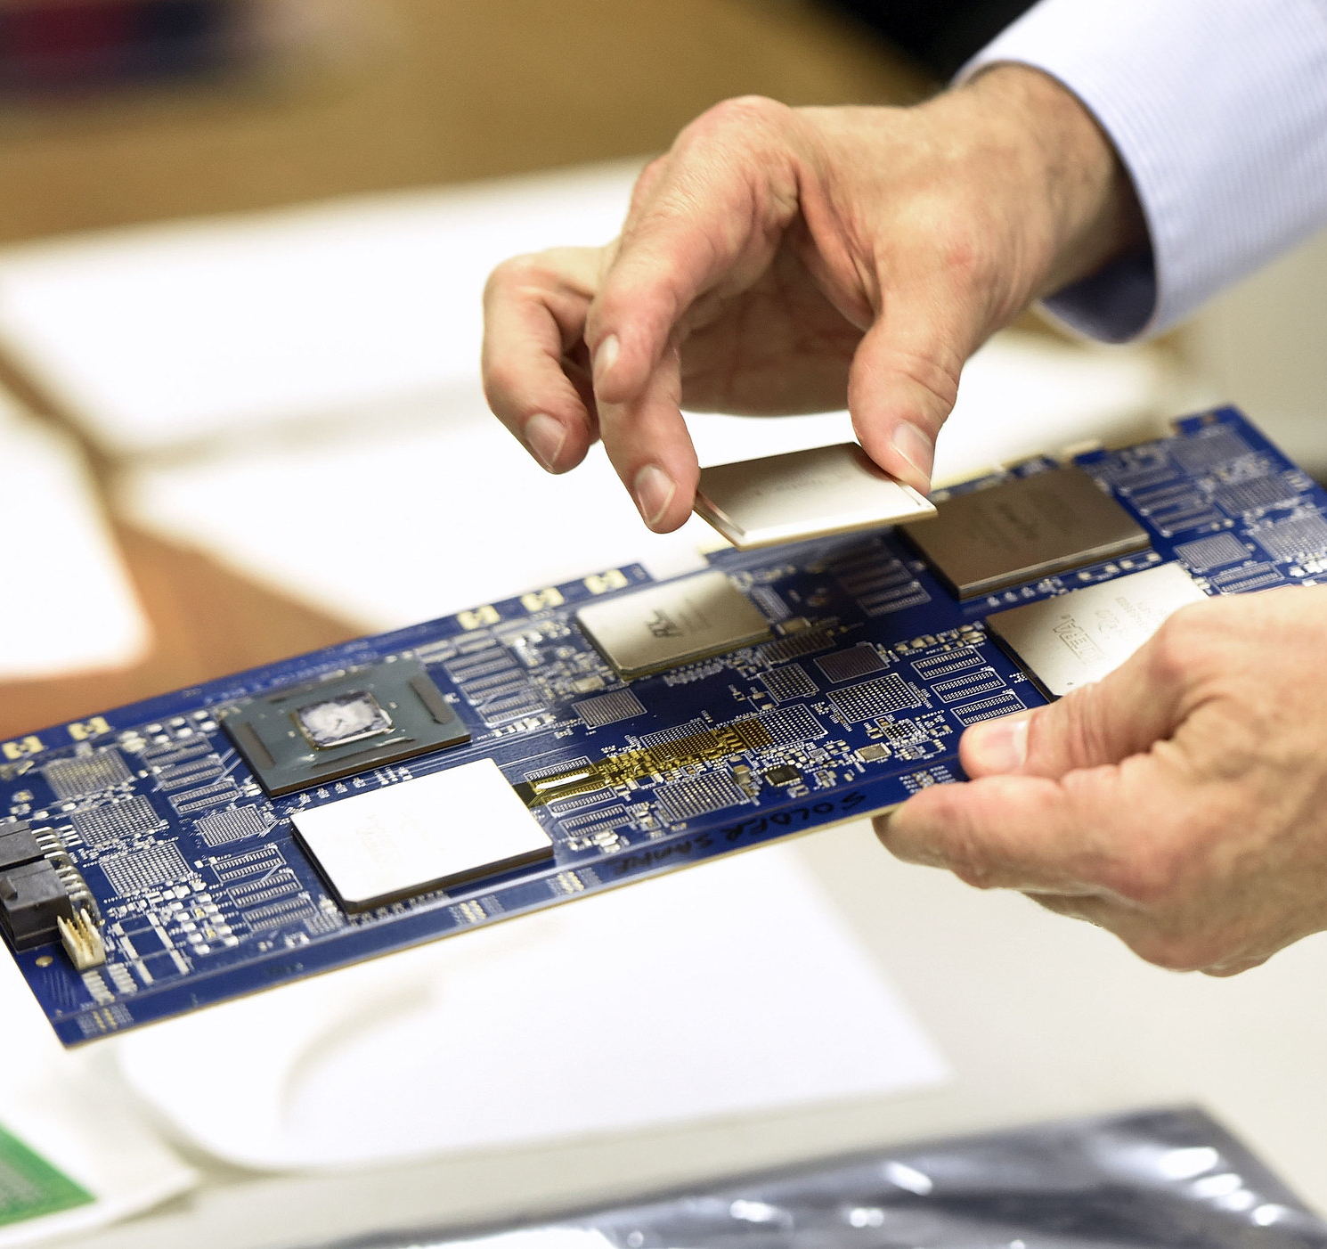
Microelectronic Parts and Materials
Microelectronics consist of the same components as regular electronics, only smaller:
transistors
capacitors
inductors
resistors
diodes
insulators
conductors
Microelectronics are made of common raw materials, including silicon, silicon crystals, and metal nitrides.
Source: tak.gov
DISTRIBUTION STATEMENT A. Approved for public release: distribution unlimited.

Slide 4
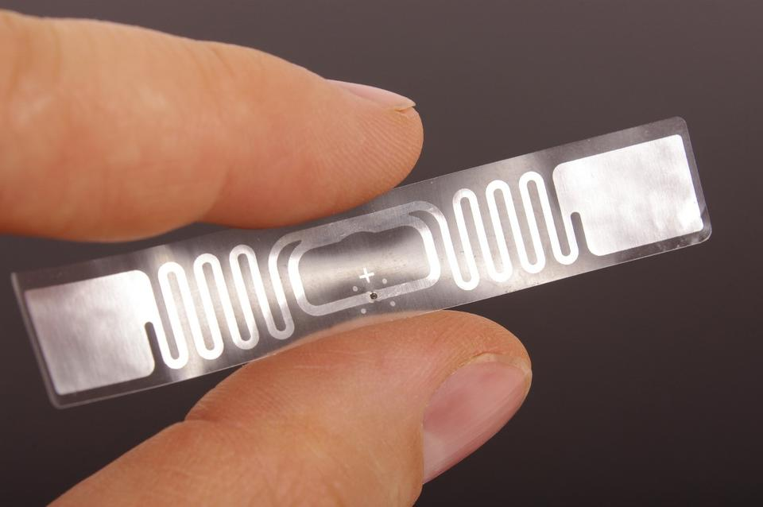
Example: Radio Frequency Identification (RFID)
Wireless tech that uses electromagnetic frequency to identify a given entity.
Most seen in passports, vehicles, pets, cards, smartphones, key fobs, etc.
One of the most common everyday interactions using microelectronics.
Source: Nist.gov
DISTRIBUTION STATEMENT A. Approved for public release: distribution unlimited.

Slide 5
The Importance of Microelectronics to the DoD (1/3)
Microelectronics play a large role in state-of-the-art technology.
Modern technology depends on semiconductor technology.
Microelectronics are used to increase efficiency and decrease size.
One of the foundations of U.S. military strategy and national security is maintaining technological superiority. As microelectronics is a rapidly developing field in the defense and commercial industries, it is an essential field of study for U.S. technological superiority.
Relevant end-user applications include miniaturizing soldier payload, increasing functionality per unit volume, and providing flexible electronics.
Applicable technology areas include advanced sensing, electronic warfare, information technology, and communication systems.
DISTRIBUTION STATEMENT A. Approved for public release: distribution unlimited.

Slide 6
The Importance of Microelectronics to the DoD (2/3)
The design of some of the components is done within the United States. However, most of the fabrication, packaging, and testing steps are done offshore.
This presents a supply chain security risk in that there is no guarantee that these electronics return without backdoors, malicious codes, and data exfiltration methods.
One of the keys to fully harnessing the capabilities of microelectronics is to ensure that the United States can have full “lab-to-field” development and production processes conducted locally.
This will allow not only security but exclusive, tailored technology of these developed capabilities for U.S. use.
DISTRIBUTION STATEMENT A. Approved for public release: distribution unlimited.

Slide 7
The Importance of Microelectronics to DoD (3/3)
Understanding and creating the means to develop the full life cycle of these technologies independently are key to ensuring functionality and security.
The current semiconductor foundry market is undergoing changes, which are ultimately leading to a reduction in access to technologies available to the DoD’s Trusted Foundry Program (TFP).
The DoD TFP assures the integrity of integrated circuits during design and manufacturing.
This will cause the DoD to more heavily rely on commercial electronic providers.
This drives the need for effective trust and assurance techniques.
DISTRIBUTION STATEMENT A. Approved for public release: distribution unlimited.

Slide 8
Current State-of-the-Art Technology
Spintronics and Next-Generation Microelectronics (New Materials/Parts)
Spintronics/magnetoelectronics utilize ferromagnetic material compounds with an inherent magnetic behavior to capture the spin state of electrons.
This is now used for creating other technologies, such as mass storage devices and magnetic random-access memory (MRAM).
Wire Bonding (Development Technique)
Due to the size of microelectronics, techniques like this have been developed to continue pushing boundaries of how small components, leads, and pads can become.
Electronic Design Automation (New Software)
Otherwise known as electric computer-aided design (ECAD), this is a category of software tools for designing electronic systems like integrated circuits and PCBs.
Also used to design and analyze semiconductor chips and integrated circuits.
DISTRIBUTION STATEMENT A. Approved for public release: distribution unlimited.

Slide 9
Current and Future Challenges
Outsourcing presents security risks and increased costs compared to production on home soil.
Consumer demand severely outpacing production capabilities and accessibility to raw materials.
Specifically, the COVID-19 pandemic contributed to a global chip shortage in which increased demand exceeds the supply, affecting more than 169 industries.
The tighter trace/space on circuit boards causes signal loss, which leads to diminished battery life and less-efficient energy usage.
For devices such as Internet of Things (IoT) sensors and implants, recharging may be unfeasible or impossible, as the devices themselves are simply unreachable, putting an absolute requirement on impressive battery life.
DISTRIBUTION STATEMENT A. Approved for public release: distribution unlimited.

Slide 10
Current Powers in the Field
Intel Corp. (INTC)
Integrated device manufacturer that designs and manufactures motherboard chipsets, network interface controllers, and integrated circuits. Initially starting as memory chips (including the world's first metal oxide semiconductor), Intel has grown to be the largest semiconductor vendor by a decent margin.
Qualcomm Inc.
(QCOM)
Semiconductor and telecommunications company that designs wireless communication products and services. Worldwide use of CDMA (code division multiple access) technology. Played a key role in the development of wireless communications. The creator of the Snapdragon chipsets found in mobile devices.
Taiwan Semiconductor Manufacturing Co. Ltd. (TSM)
One of the largest dedicated, independent pure-play semiconductor foundries. They only fabricate integrated circuits and do not have design capabilities in house. Many semiconductor companies outsource manufacturing to TSM.
Broadcom Inc. (AVGO)
Digital/analog semiconductors, interfaces for Bluetooth, routers, switches, processors, and fiber optics.
Micron Technology Inc. (MU)
International semiconductor products for computers, consumer electronics, automobiles, communications, and servers. Also makes flash RAM products as well as rewritable disc storage solutions.
DISTRIBUTION STATEMENT A. Approved for public release: distribution unlimited.

Slide 11
Conclusion
Microelectronics are key to establishing more efficient and convenient technology.
Creation of a U.S.-based, DoD-specific supply chain and “field-to-lab” pipeline will be of utmost importance to ensure the security of microelectronics.
The demand for microelectronics will only increase with the rise in IoT, automotive industry integration, and demand for smaller, cheaper consumer electronics.
Supply shortages and the increased signal loss due to circuit board density are key challenges that need to be addressed.
DISTRIBUTION STATEMENT A. Approved for public release: distribution unlimited.

Slide 12
Further Resources
https://www.thetechoutlook.com/news/defense/state-of-the-art-microelectronics-technologies-for-u-s-air-force-with-194-3m-contract-won-by-kbr/
https://www.defense.gov/News/News-Stories/Article/Article/2320194/dod-can-lead-microelectronics-manufacturing-back-to-us/
http://www.ndia.org/-/media/sites/ndia/divisions/electronics/ndia-ed-mtg-020719_jeremy-muldavin_overview-vf.ashx?la=en
Moore's Law and Intel Innovation
Microelectronics - DoD Modernization Priorities – DoDTechipedia
The Benefits and Challenges of Microelectronics Designs | Sierra Circuits (protoexpress.com)
These 169 industries are being hit by the global chip shortage (yahoo.com)
DISTRIBUTION STATEMENT A. Approved for public release: distribution unlimited.

